Slide 1
Image Fusion based on Flower Pollination Algorithm Optimization and Stationary Wavelet Transform.
Guide : Fousia M. Shamsudeen
Surabhi S
S6 MCA

Slide 2
Abstract
In this base paper it mainly focus about the best image fusion algorithm, one of the important thing is one image is panchromatic(black and white) and other is multi-spectral (colored). This images are integrated using adaptive fusion technology and decomposes the original image using stationary wavelet transformation by choosing optimum weight from swarm flower pollination optimization algorithm.

Slide 3
Proposed System
This paper is proposes the remote sensing image fusion based on more efficient Genetic Algorithm ie, FPA.
First, the source images decomposed by the Stationary Wavelet Transforms (SWT).
Then FPA optimized the weight of fusion rule.
Finally, the Inverse SWT reconstructed fused image.

Slide 4
Phases Involved
Pre-processing
Decomposition
Adaptive fusion based on FPA
Reconstruction

Slide 5
Tools
Language : Python
IDE : Pycharm

Slide 6
Pre Processing
Resizing image
Decomposition
Decomposing images into 4 images, 1 approximation and 3 detailed images and further decomposes approximation images into another approximation and 3 detailed images and so on up to the no. of levels we specified.

Slide 7
Goal
Our aim is to fuse the images without any loss and minimize the G, for that.
Choose appropriate weight for adaptive fusion and it holds value [0,1] using FPA optimization.
Find “G” , is the difference between original image and fused image. Its value should be minimum so iterate these steps until we get minimum G.

Slide 8
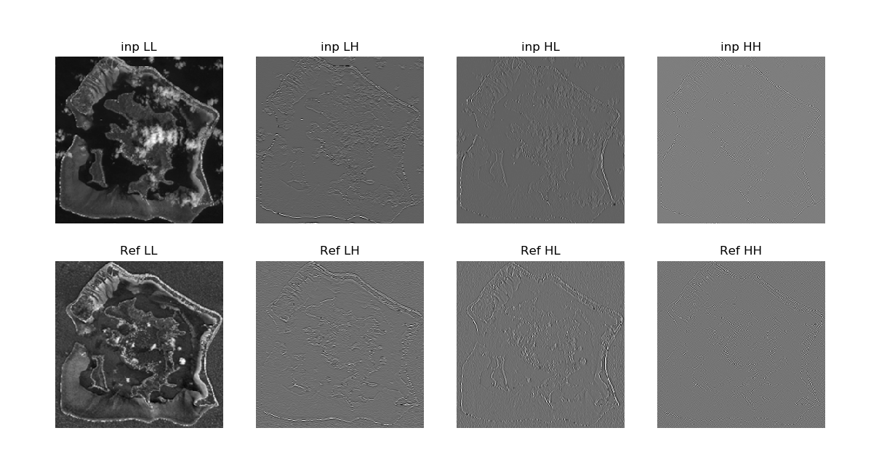
Screenshot of decomposed image

Slide 9
Thank You

